Slide 1
Adapter DESIGN Pattern
Team 1:
Srichakradhar reddy nagiReddy
SatHwik banginimatam
Pavan kumar Yannamaneni
Ravindra reddy chennapareddy

Slide 2
Introduction
Adapter pattern works as a bridge between two incompatible interfaces
Converts one interface to another so that it matches what the client is expecting
The adapter design pattern solves problems like:
How can a class be reused that does not have an interface that a client requires?
How can classes that have incompatible interfaces work together?
How can an alternative interface be provided for a class?

Slide 3
Usage
To use an adapter:
The client makes a request to the adapter by calling a method on it using the target interface.
The adapter translates that request on the adaptee using the adaptee interface.
Client receive the results of the call and is unaware of adapter’s presence
In design, adapters are used when we have a class (Client) expecting some type of object and we have an object (Adaptee) offering the same features but exposing a different interface.

Slide 4
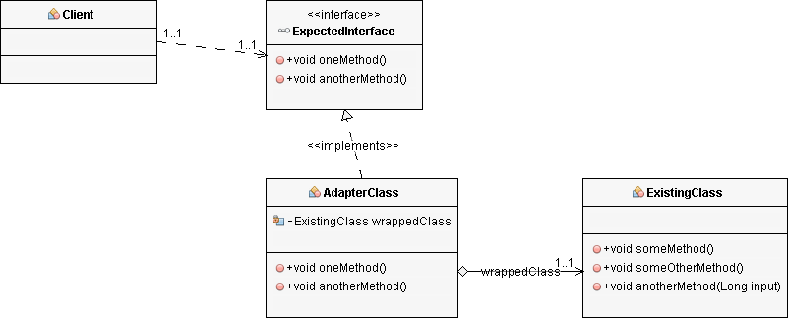
UML DESIGN

Slide 5
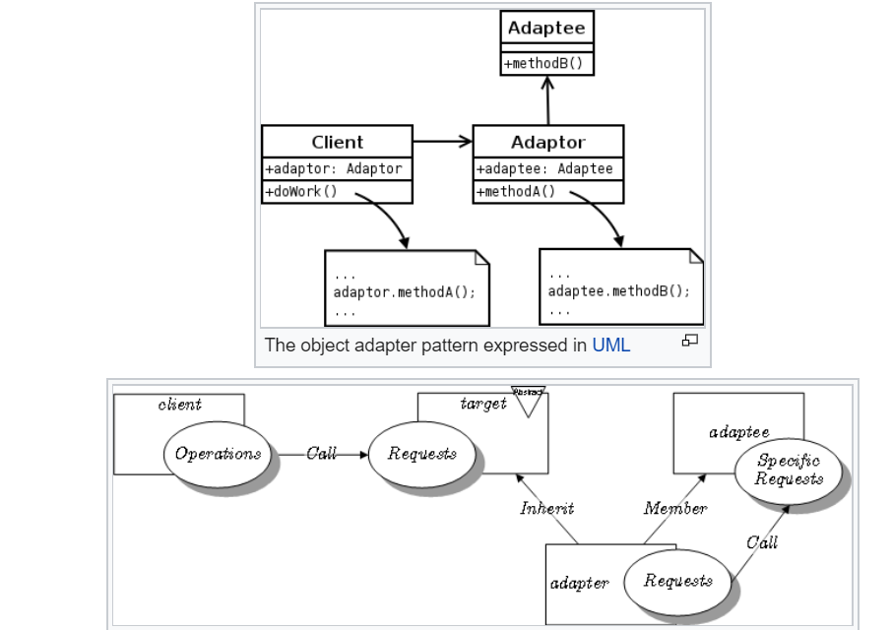
Object adapter pattern

Slide 6
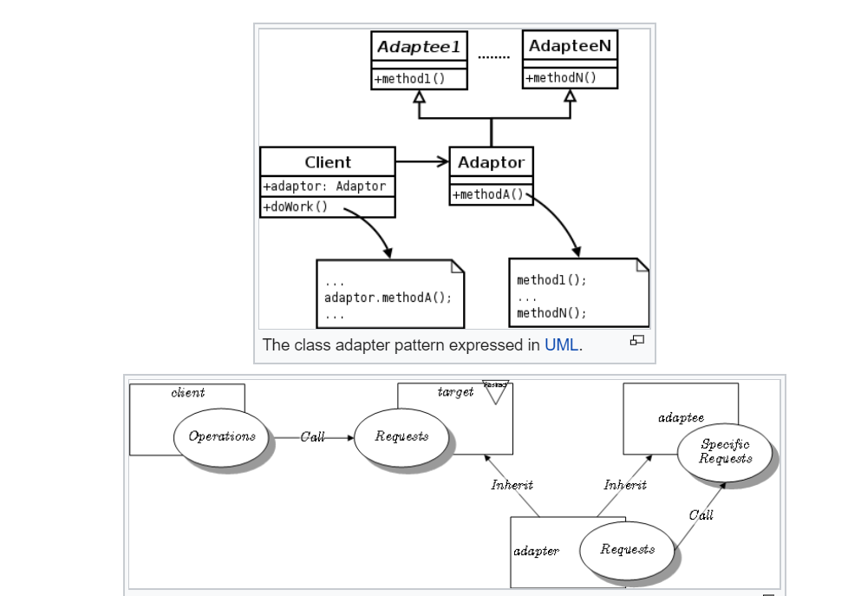
Class adapter pattern

Slide 7
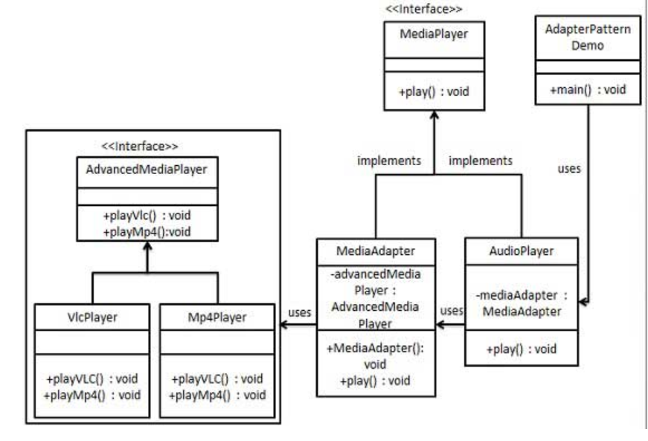
IMPlementation

Slide 8
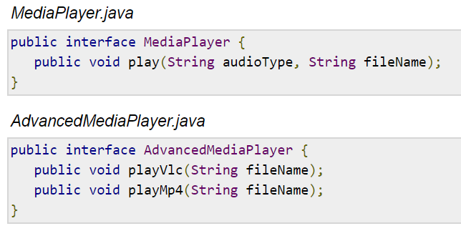
Code
Step 1: Create interfaces for Media Player and Advanced Media Player

Slide 9
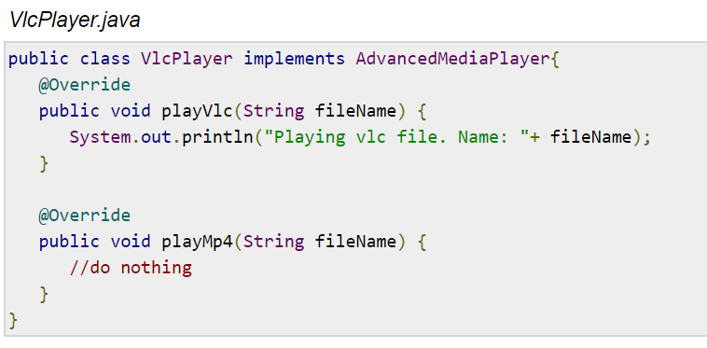
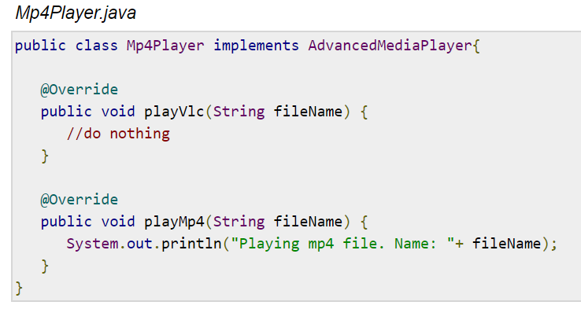
Step 2: Create concrete classes implementing the AdvancedMediaPlayer interface

Slide 10
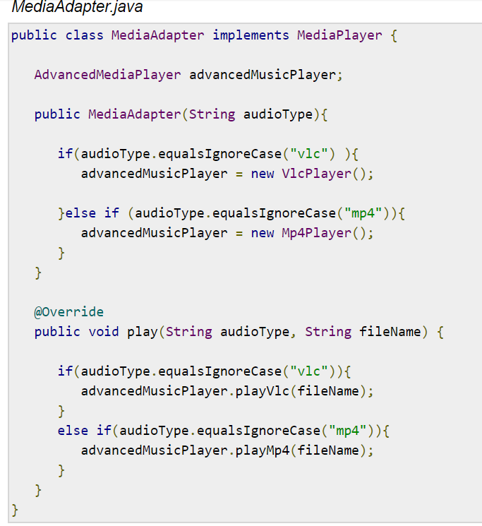
Step 3: Create adapter class implementing the MediaPlayer interface.

Slide 11
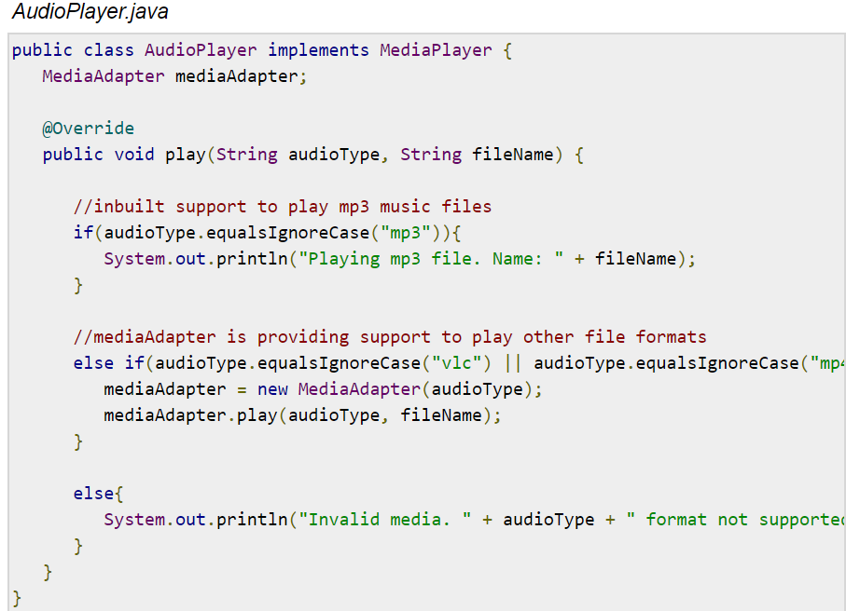
Step 4: Create concrete class implementing the MediaPlayer interface.

Slide 12
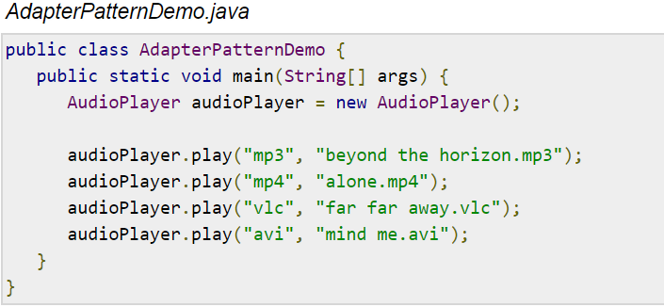
Step 5: Use the AudioPlayer to play different types of audio formats.

Slide 13
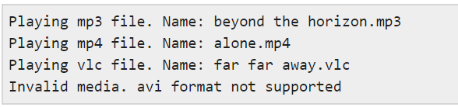
Step 6: Verify the output

Slide 14
QUIZ
When do we need adapter pattern?
What is the difference between Object Adapter and Class Adapter?
Which Design Pattern should you use when you want to use an existing class, and its interface does not match the one you need?
Which one of the following is not a participant in Adapter pattern?
A. Target
B. Client
C. Adaptee
D. ConcreteTarget

Slide 15
THANK YOU

